Slide 1
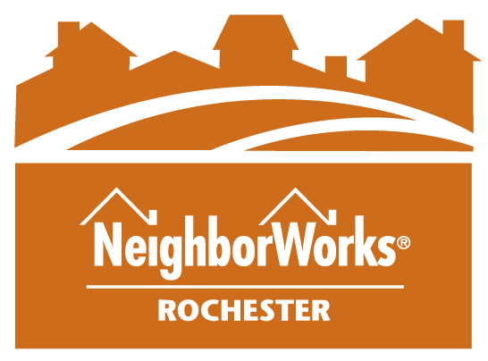
NeighborWorks® Rochester
& The Triangle of North Winton Village

Slide 2
Our Work
Homeownership
Financial Fitness
Community Lending & Grants
Energy Efficiency
Community Initiatives
Targeted Neighborhood Stabilization

Slide 3
Healthy Blocks
Physical Conditions
Residential
Commercial Corridors
Public Spaces
Social Engagement
Events
Community Projects
Neighborhood Image
Logo & “Marketing”
Social Media

Slide 4
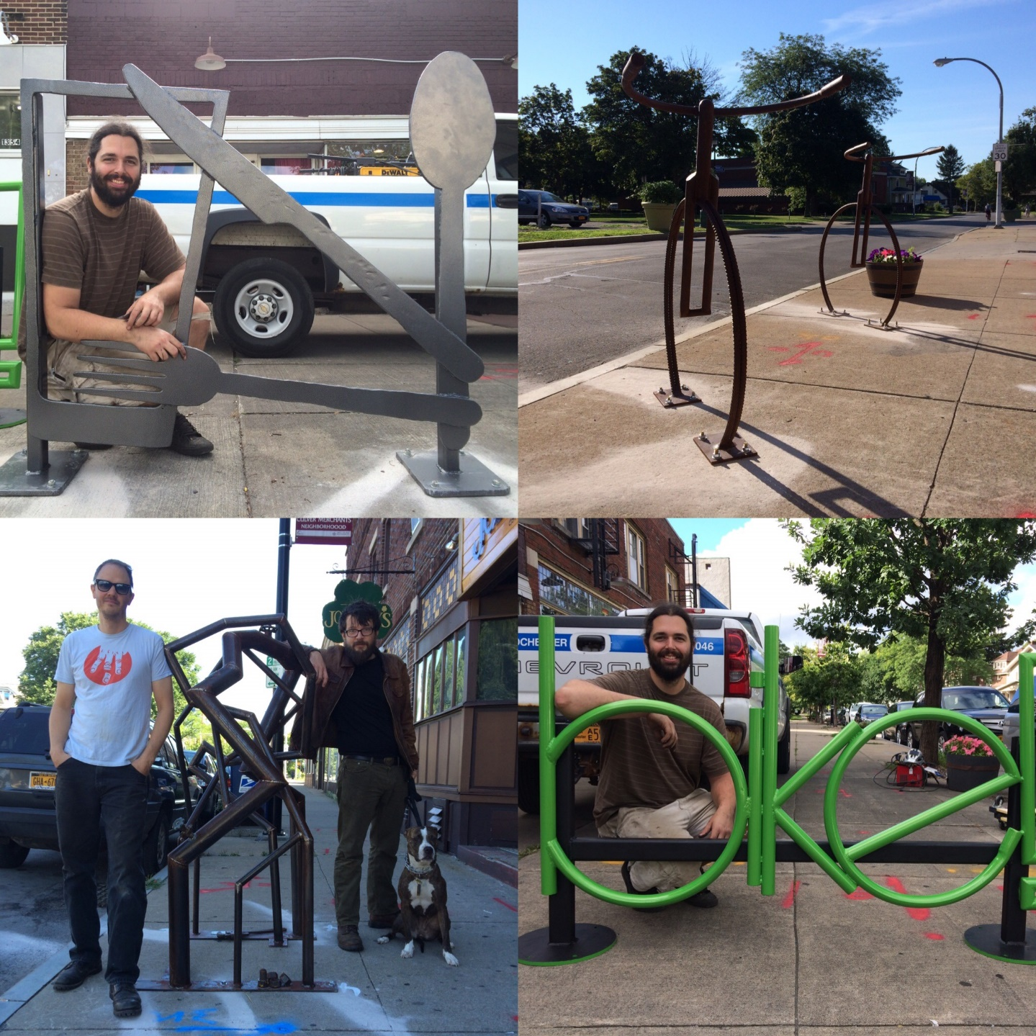
Bike Rack Installations with Local Artists Jesse Hughson and MetalSomeArt

Slide 5
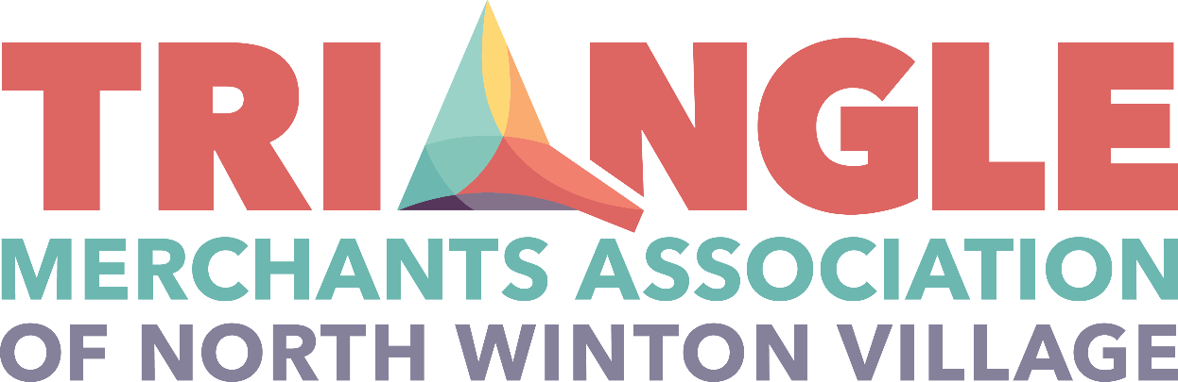
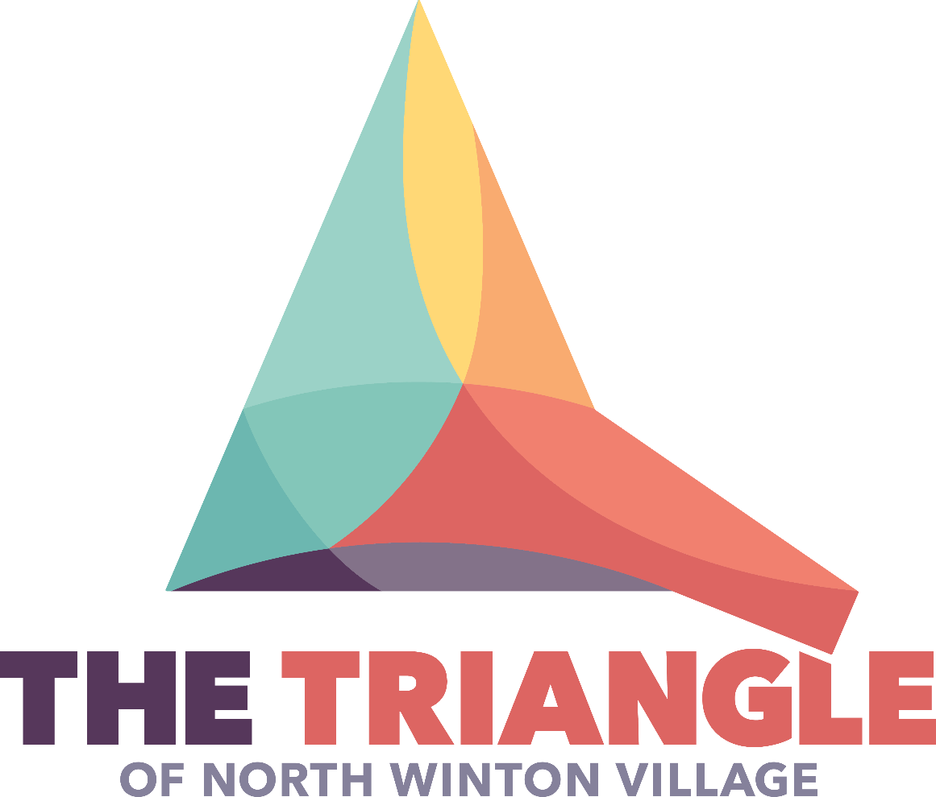

Neighborhood Logos

Slide 6
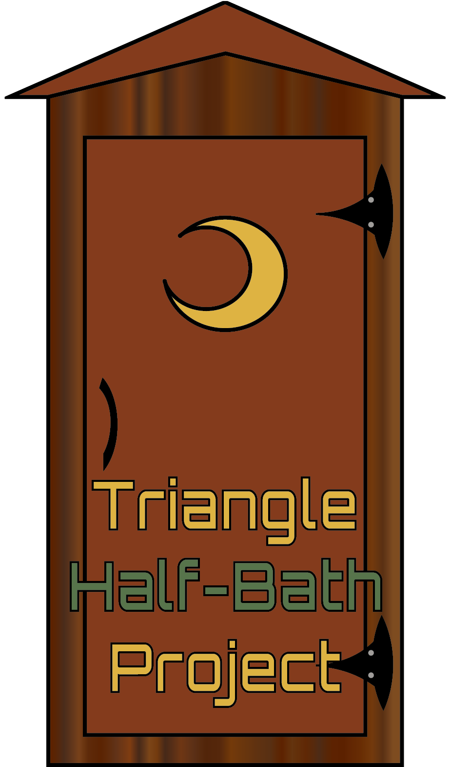
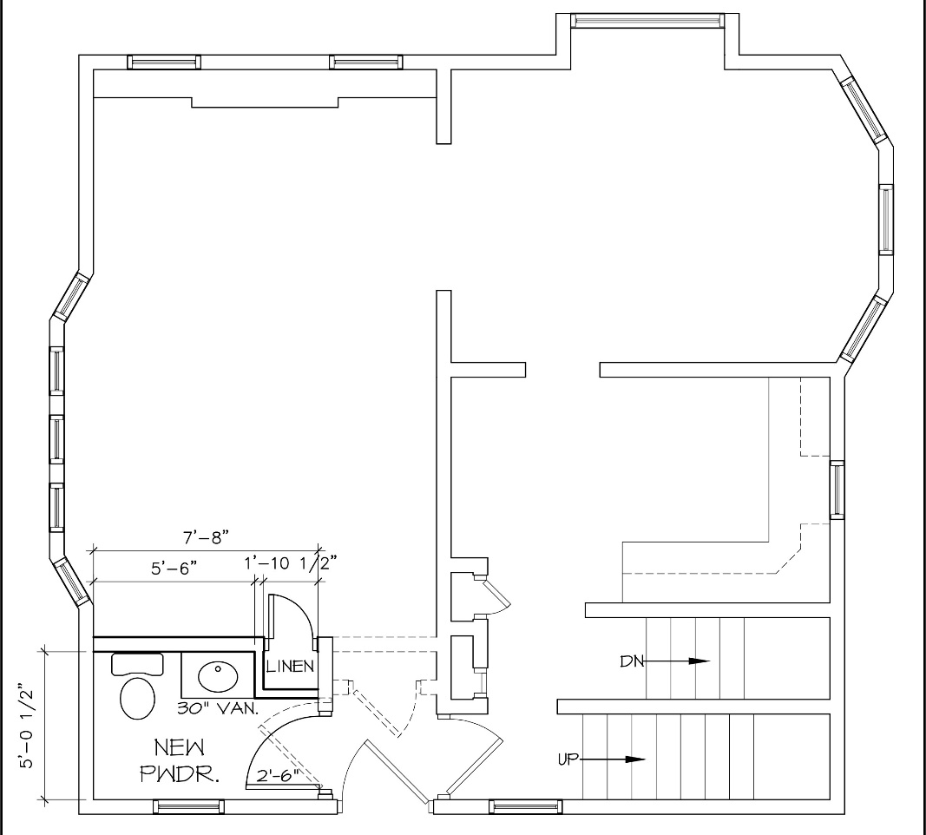
Half-Bath Project
Increase Resident Stability
Decrease Investor Interest
Target smaller properties with low or moderate assessed value

Slide 7
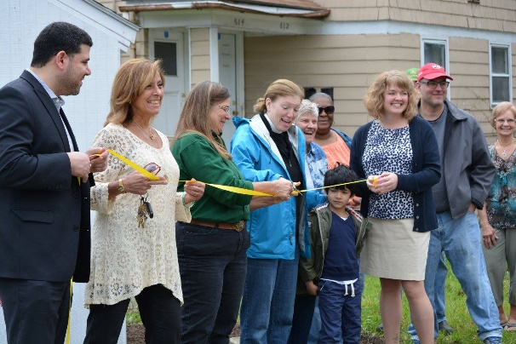
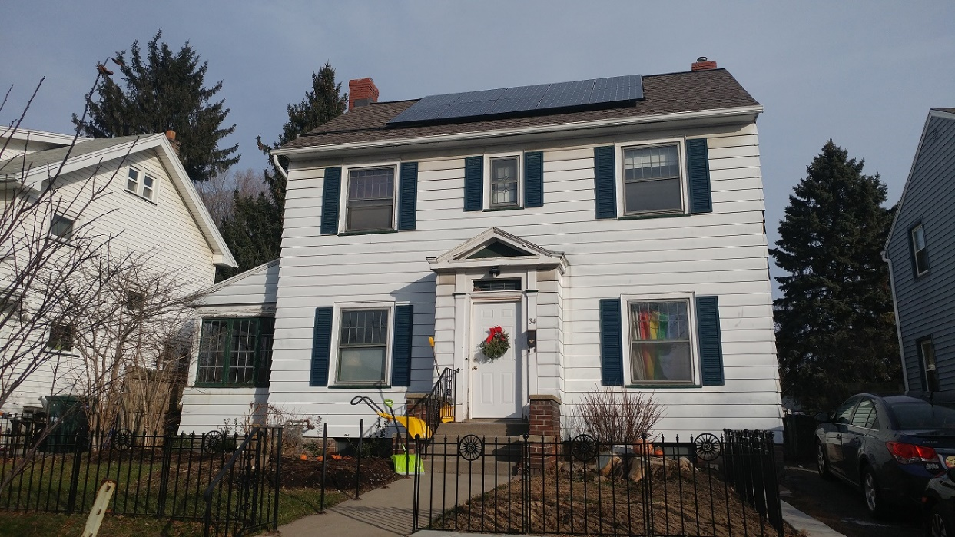
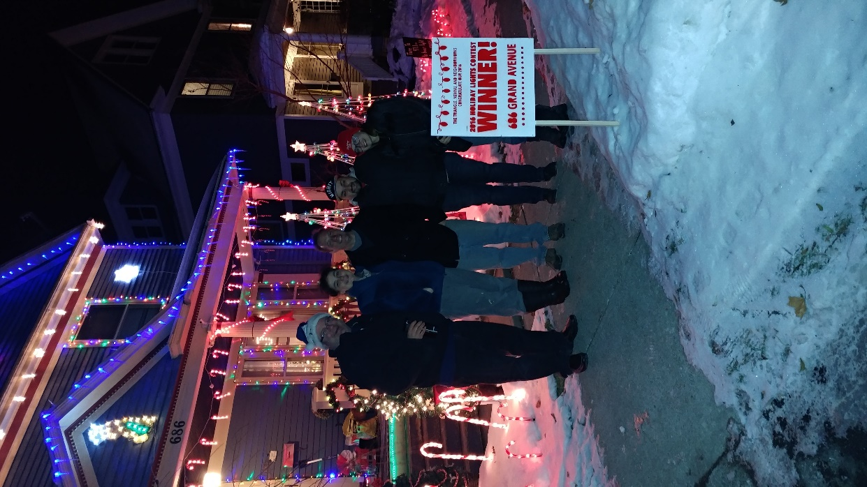
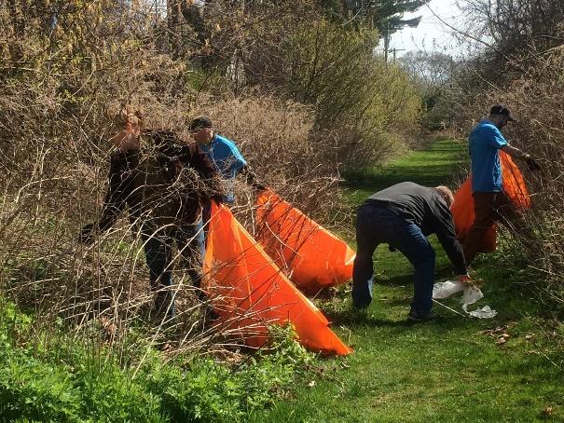
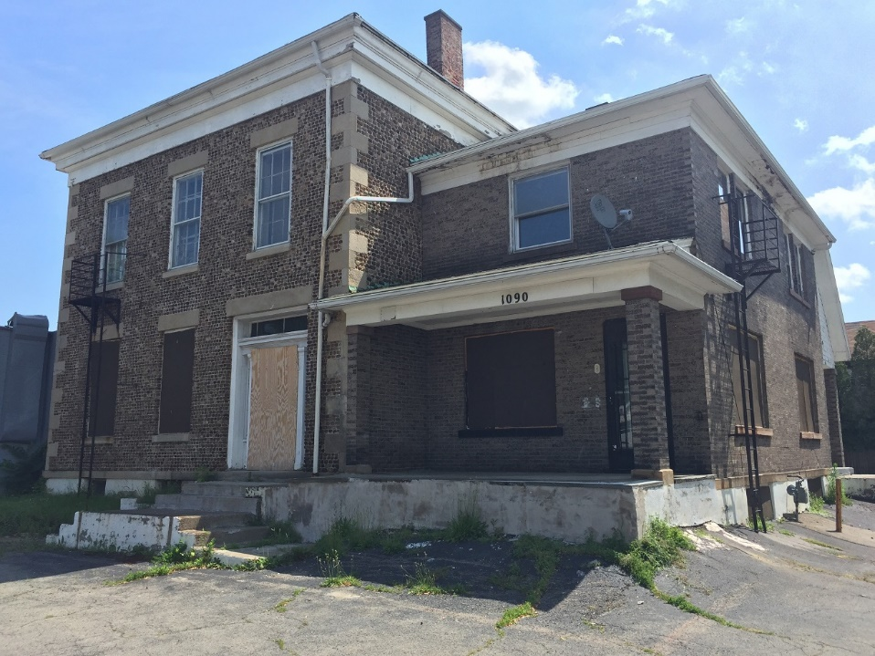
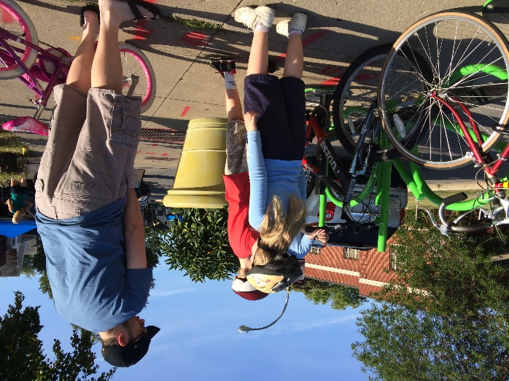
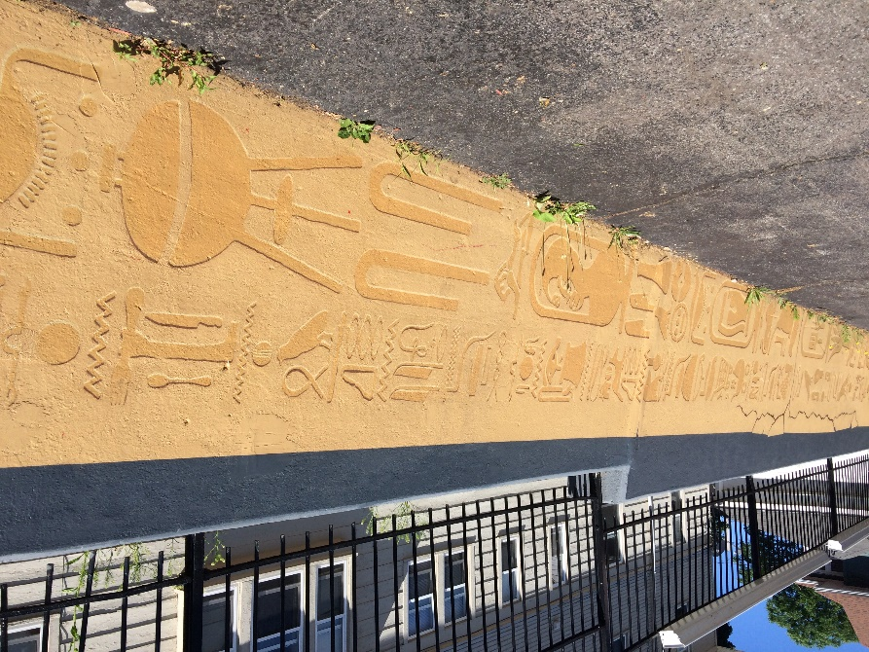

Slide 8
2016 Community Impact Measurement Surveys
200 Responses from a Random Sample of 450 households
Mostly taken door-to-door
Contribution from Triangle neighbors, NeighborWorks volunteer, AmeriCorps
Rationale for Geographic Areas
Understanding neighborhood dynamics
Targeting outreach
Impact of projects and programs

